Slide 1
2ND SEM PROJECT ON GAME DEVELOPMENT USING UNITY
BY ARUNABHA MISHRA
SAHIL SARASWAT
UID – 23BCB10026
23BCB10079

Slide 2
PRESENTATION FLOW
Introduction
Building confidence
Engaging the audience
Visual aids
Final tips & takeaways

Slide 3

INTRODUCTION
Welcome to Flappy Bird Game, a thrilling 2D mobile game designed to captivate players with its addictive gameplay and vibrant visuals. Guide your feathered friend through a maze of obstacles, testing your reflexes and skills as you soar to new heights. With intuitive touch controls and engaging challenges, Flappy Bird promises endless entertainment for players of all ages. Get ready to experience the excitement of Flappy Bird!

Slide 4
TOOLS AND COMPONENTS
UNITY
C# Language
Angry Bird
Pipe

Slide 5
GAME DESIGN AND CONCEPT
Our Flippy Bird game is a vibrant 2D mobile game where players control a bird navigating through obstacles in a whimsical world.
Key Elements:
Theme and Setting: Explore a magical world filled with lush landscapes and towering obstacles.
Gameplay Mechanics: Tap to flap the bird's wings and navigate through gaps in the obstacles.
Objective: Guide the bird as far as possible while avoiding collisions with obstacles.
Scoring System: Earn points for clearing obstacles and reaching new milestones.

Slide 6
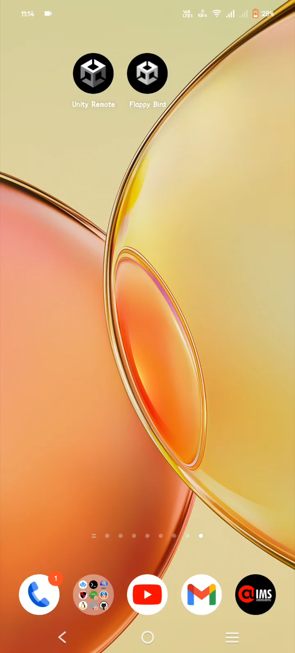
PROCESS OF PLAYING THE GAME GIVEN BELOW IN THE VIDEO

Slide 7
MANUALY USE OF THE GAME
TO PLAY THE GAME YOU SHOULD TAP THE SCREEN TO ALIVE THE BIRD.
HERE IS THE MAIN THINGS THAT IS PIPE. YOU CAN'T TOCUH THE PIPE OTHERWISE YOU WILL BE OUT.
YOU MUST HAVE THE SKILL TO PLAY THE GAME.

Slide 8
Conclusion
Flappy Bird is more than just a game - it's an immersive experience that combines intuitive controls, captivating visuals, and addictive gameplay to provide endless entertainment for players of all ages. With its dynamic obstacles, vibrant landscapes, and competitive scoring system, Flappy Bird offers an exciting journey through a whimsical world where every flap of your bird's wings brings you closer to victory.
Embark on this adventure, challenge your reflexes, and soar to new heights as you strive for the highest score. Whether you're a casual gamer looking for a quick thrill or a seasoned player seeking a new challenge, Flappy Bird is sure to keep you coming back for more.
Thank you for joining us on this journey through the colorful and exhilarating world of Flappy Bird. Get ready to spread your wings and experience the excitement today!

Slide 9
SOME IMPORTANT LINKS
APP LINK
GITHUB LINK
LINKEDIN LINK

Slide 10
Thank you
Arunabha Mishra
+91-8710065649
Arunabhamishra39@gmail.com
www.linkedin.com/in/arunabha-mishra-a35128245/

